Slide 1
Language Difference and its Translation

Slide 2
Contents
Language conception
Language system
Language use
Class practice

Slide 3
Warm-up Translation
1. I have a habit of writing in deep night.
2. In case of difficulty, you can reach me at this number.
3. You can make it practically.

Slide 4
DIFFERENT CONCEPTIONS ON LANGUAGE

Slide 5
《易·系辞上》：
书不尽言，
言不尽意，
然则是圣人之意其不可见乎？
子曰：
圣人立象以尽意。
One cannot write what one intends to say.
Neither does one express the meaning in mind fully.
Then is the sage’s idea unsearchable?
Confucius says, the sage will set image to express.

Slide 6
禅宗(Zen)：
教外别传，
不立文字，
直指人心，
见性成佛。
Teach beyond the doctrine,
Not from the words.
Go direct to man’s heart,
and his pure nature.

Slide 7
Bible
In the beginning was the Word, and the Word was with God, and the Word was God.
He was in the beginning with God.
太初有话，话与神同在，话就是神。
祂起初就与神同在。

Slide 8
枯藤老树昏鸦
小桥流水人家
古道西风瘦马
夕阳西下
断肠人在天涯
Withered vines hanging on old branches,
Returning crows croaking at dusk.
A few houses hidden past a narrow bridge
And below the bridge a quiet creek running.
Down a worn path, in the west wind,
A lean horse comes plodding.
The sun dips down in the west.
And the lovesick traveler is still at the end of the world.

Slide 9
Major Difference
Logical in grammar VS Imaginative in rich images

Slide 10
Different language systems and features

Slide 11





Phonetic VS ideographic /
Hypotaxis(形合） VS Parataxis（意合）
Chinese character
CAT [kæt]

Slide 12

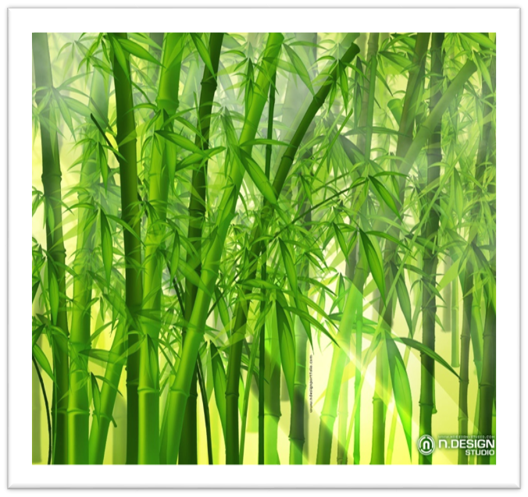
Tree-type ＆ bamboo-type；
Collective VS scattering

Slide 13
Tree-type ＆ bamboo-type；Collective VS scattering
I was all the more delighted (1)when , as a result of the initiative of your government(2), it proved possible to reinstate the visit(3).
由于贵国政府的提议(2) ，才得以这样快地重新实现访问(3)，这使我特别高兴(1)。
We had been dismayed at home(1) while reading of the natural calamities(2) that followed one another for three years (3)after we left China in 1959(4).
我们于1959年离开了中国。(4)此后，中国连续三年遭受自然灾害。(3)当我们在家读到这方面的消息时，(2)心情颇为低沉(1)。

Slide 14
Longer sentence vs shorter sentence
In the doorway lay at least twelve umbrellas of all sizes and colours.
门口放着一堆雨伞，少说也有十二把，五颜六色， 大小不一。
All was cleared up some time later when news came from a distant place that an earthquake was felt the very day the little copper ball fell.
过了一些时候，从远方传来了消息：在小铜球坠落的当天，确实发生了地震。这一切终于得到了澄清。

Slide 15
Four-character phrase
Disintegration
土崩瓦解
Ardent loyalty
赤胆忠心
Far-sightedness
远见卓识
Perfect harmony
水乳交融
Careful consideration
深思熟虑
Total exhaustion
精疲力尽
Feed on fancy
画饼充饥
With great eagerness
如饥似渴
Offend public decency
伤风败俗
Await with great anxiety
望穿秋水

Slide 16
Static VS Dynamic
He is a good eater and sleeper.
他能吃能睡。
Rockets have found application of the exploration of the universe.
火箭已经用来探索宇宙。
The doctors extremely quick arrival brought about his very speedy recovery.
医生迅速到达，病人很快就康复了。

Slide 17
Indirect VS Direct
Would you mind opening the window?
请开一下窗。
Would it be possible for me to take three days off next month?
我可不可以在下个月请三天假？
Can I help you?
你想买点什么？
You are late for the last time.
你被解雇了。

Slide 18
Objective VS Subjective
What happened to you?
你怎么啦？
An idea suddenly struck me.
我突然想到一个主意。
The thick carpet killed the sound of my foot steps.
我走在厚厚的地毯上，一点声音都没有。

Slide 19
Passive VS Active voice
发现了错误，就一定要改正。
Wrongs must be righted when they are discovered.
看树看果实，看人看作为。
A tree is known by its fruit, and a man is known by his actions.
中美已经建立了外交关系。
Diplomatic relations have been established between China and the United States.

Slide 20
Thing VS Human
It is believed…
人们相信……
It is reported
据报道……
It is estimated
据估计……
It must be admitted that…
必须承认……
It has been found that…
已经发现……
It is agreed that…
人们认为……

Slide 21
It is rumored that the accident was due to negligence.
有传言说（大家都在议论说），那场事故是由于玩忽职守造成的。
It is a pity that I have to leave this company.
很遗憾，我今年要离开这家公司了。
It rests with you to decide.
你来决定吧。

Slide 22
Difference between Chinese and English
English | Chinese
Phonetic | Ideographic
Hypotaxis | Parataxis
longer sentence | shorter sentence/four-character expression
indirect | direct
collective (like tree) | scattering (like bamboo)
static | dynamic
passive | active
Objective/thing | Subjective/man

Slide 23
Oral Practice:
1.The sight of the big tree always reminds me of my childhood.
2.It must be pointed out that…
3.He is the best hater I have known.
4.There are many wonderful stories to tell about the places I visited and the people I met.

Slide 24
KEY:
1.The sight of the big tree always reminds me of my childhood.
一看见这棵大树，我就想起了童年。
这棵大树总是勾（唤）起我对童年的回忆。
2.It must be pointed out that…
必须指出…
3.He is the best hater I have known.
他是我认识的人中最爱记仇的人。
4.There are many wonderful stories to tell about the places I visited and the people I met.
我到过很多地方，见过很多人，有很多有趣的故事要讲。
关于我所到过的地方，我遇见的人，事事美妙，皆可述说。

Slide 25
Paragraph translation(E-C, C-E)

Slide 26
Paragraph practice(E-C)
The striking contrast between the technological sophistication employed in the diagnosis of the problem and the lack of international collaboration or political sophistication when it comes to solving it illustrates the crisis of technological civilization. As a species we have shown enough cleverness to disrupt the world's climate, but may not have enough to remedy the heavy toll that we have taken on climate. Things are of course made much worse by the presence in the White House of an aggressively ignorant and anti-science administration. Ignorance about the size of the threatened rise in the sea levels is no excuse for inaction, The possibility of this disaster must spur us into drastic action to curb global warming.

Slide 27
Paragraph practice(C-E)
在诊断问题时，采用了尖端技术，而在解决问题时，却缺少国际合作或完善的政治方案，这两者之间的鲜明对照说明技术文明面临着危机。作为一个物种，我们有足够多的聪明才智干扰全球的气候，但在修补对气候造成的巨大破坏时却显得愚蠢。当然雪上加霜的是当前的美国政府不仅孤陋寡闻、反对科学，而且胆大妄为。不了解海平面上升的威胁程度绝不是不作为的借口。发生灾难的可能性迫使我们采取重大行动遏制全球变暖。

Slide 28
The striking contrast between the technological sophistication employed in the diagnosis of the problem and the lack of international collaboration or political sophistication when it comes to solving it illustrates the crisis of technological civilization.
在诊断问题时，采用了尖端技术，而在解决问题时，却缺少国际合作或完善的政治方案，这两者之间的鲜明对照说明技术文明面临着危机。

Slide 29
The striking contrast between the technological sophistication employed in the diagnosis of the problem and the lack of international collaboration or political sophistication when it comes to solving it illustrates the crisis of technological civilization.As a species we have shown enough cleverness to disrupt the world's climate, but may not have enough to remedy the heavy toll that we have taken on climate. things are of course made much worse by the presence in the White House of an aggressively ignorant and anti-science administration. Ignorance about the size of the threatened rise in the sea levels is no excuse for inaction, The possibility of this disaster must spur us into drastic action to curb global warming.
在诊断问题时，采用了尖端技术，而在解决问题时，却缺少国际合作或完善的政治方案，这两者之间的鲜明对照说明技术文明面临着危机。作为一个物种，我们有足够多的聪明才智干扰全球的气候，但在修补对气候造成的巨大破坏时却显得愚蠢。当然雪上加霜的是当前的美国政府不仅孤陋寡闻、反对科学，而且胆大妄为。不了解海平面上升的威胁程度绝不是不作为的借口。发生灾难的可能性迫使我们采取重大行动遏制全球变暖。

Slide 30
Paragraph practice(E-C, C-E)
The striking contrast between the technological sophistication employed in the diagnosis of the problem and the lack of international collaboration or political sophistication when it comes to solving it illustrates the crisis of technological civilization. As a species we have shown enough cleverness to disrupt the world's climate, but may not have enough to remedy the heavy toll that we have taken on climate. things are of course made much worse by the presence in the White House of an aggressively ignorant and anti-science administration. Ignorance about the size of the threatened rise in the sea levels is no excuse for inaction, The possibility of this disaster must spur us into drastic action to curb global warming.

Slide 31
Thanks

